Slide 1
Work-case 3
Performed by student
group RPZ-13a
Kateryna Hranat

Slide 2
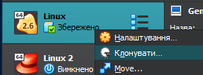
Cloning your virtual operating system
Cloning a virtual operating system in VirtualBox is a straightforward process. Follow these steps:
Shut Down the Virtual Machine: Make sure your virtual machine is powered off before you start the cloning process.
Open VirtualBox Manager: Launch the VirtualBox Manager application.
Select the Virtual Machine to Clone: In the left pane of the VirtualBox Manager, select the virtual machine you want to clone.
Click on "Clone": With the virtual machine selected, click on the "Clone" button in the toolbar or right-click on the virtual machine and choose "Clone".

Slide 3
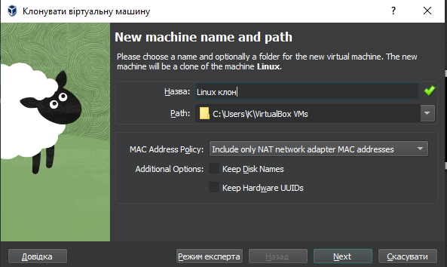
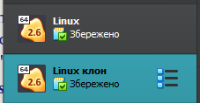
5. Configure Clone Settings: You'll be prompted to enter a name for the clone and select options for the clone. Choose the appropriate option based on your needs.
6. Choose Clone Location: Select where you want to save the clone on your disk. You can keep it in the default location or choose a different directory.
7. Start Cloning: Once you've configured the settings, click "Clone" to begin the cloning process. Depending on the size of the virtual machine and your system's performance, this process may take some time.
8. Verify the Clone: Once the cloning process is complete, you should see the new cloned virtual machine listed in the VirtualBox Manager. You can now start the cloned virtual machine and use it independently from the original.

Slide 4
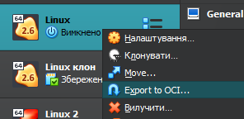
exporting your virtual operating system
How you can export your virtual operating system:
Shut Down the Virtual Machine: Make sure your virtual machine is powered off before you start the export process.
Open VirtualBox Manager: Launch the VirtualBox Manager application.
Select the Virtual Machine to Export: In the left pane of the VirtualBox Manager, select the virtual machine you want to export.
Click on "File" and then "Export Appliance": Alternatively, you can right-click on the virtual machine and choose "Export Appliance".

Slide 5
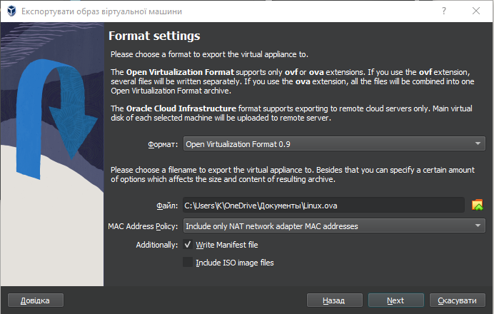
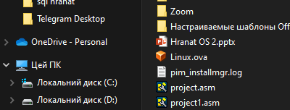
5. Configure Export Settings: In the export wizard, you'll be prompted to configure the export settings:
Choose the virtual machine(s) you want to export if you have multiple VMs.
Select the destination folder where you want to save the .ova file.
Optionally, you can adjust additional settings such as including attached ISO images or defining the format of the exported appliance (e.g., .ova or .ovf).
6. Start the Export Process: Once you've configured the export settings, click "Export" to start the export process. Depending on the size of the virtual machine and your system's performance, this process may take some time.
7. Wait for the Export to Complete: VirtualBox will create the .ova file containing all the necessary information about your virtual machine.
8. Verify the Exported Appliance: Once the export process is complete, navigate to the destination folder you selected earlier and verify that the .ova file has been created successfully.

Slide 6

types of network connection organization supported in virtual machine environments
Network Address Translation (NAT): Allows virtual machines to share the host computer's IP address for external network communication.
Bridged Network: Provides each virtual machine with its own IP address on the same network as the host, allowing them to appear as individual devices on the network.
Host-only Adapter: Creates a network that allows communication only between virtual machines and the host, isolating them from external networks.
Internal Network: Establishes a private network that allows communication between virtual machines within the same host but restricts external access.

Slide 7
Set up a network between your host OS and its clone

Slide 8
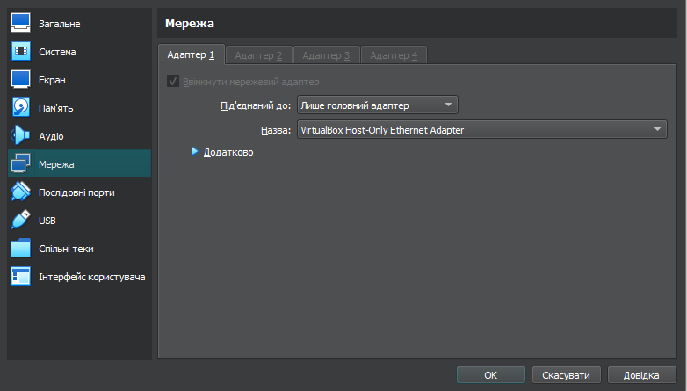
Configuring Network Parameters:
Host OS (Your Physical Machine): On your physical machine, ensure that VirtualBox is configured to use a network adapter that allows communication between the host and guest OS. You can typically use the "NAT Network" or "Bridged Adapter" option in VirtualBox settings.
Clone OS (Virtual Machine): Inside your virtual machine settings in VirtualBox, configure the network adapter to use the same network settings as the host OS. This will allow the clone to communicate with the host and access the internet.

Slide 9


Internet Access:
Start both virtual machines and ensure they have internet access. Open a browser on each virtual machine and watch any YouTube video to verify the connection. Unfortunately, I wasn't able to accomplish next exercises, but I understand the working principle.

Slide 10

Messaging between OSs over the local network
To exchange messages between two OSs, you can use tools such as `ping` or `netcat`.
For example, to send a message from the first OS to the second one, use the following commands:
ping <IP-адреса-клону>
Or: echo "Ваше повідомлення" | nc <IP-адреса-клону> <порт>
To receive the message on the second virtual machine, enter the command:
nc -l <порт>

Slide 11

Shared network folder
A virtual network folder can be configured in VirtualBox to exchange files between virtual machines and the host computer. To create a shared network folder, open the settings of the virtual machine and add a "Shared Folder" network device. After configuring access to the network folder on both virtual machines, you will be able to copy files from this folder to the user's home directory or desktop.

Slide 12
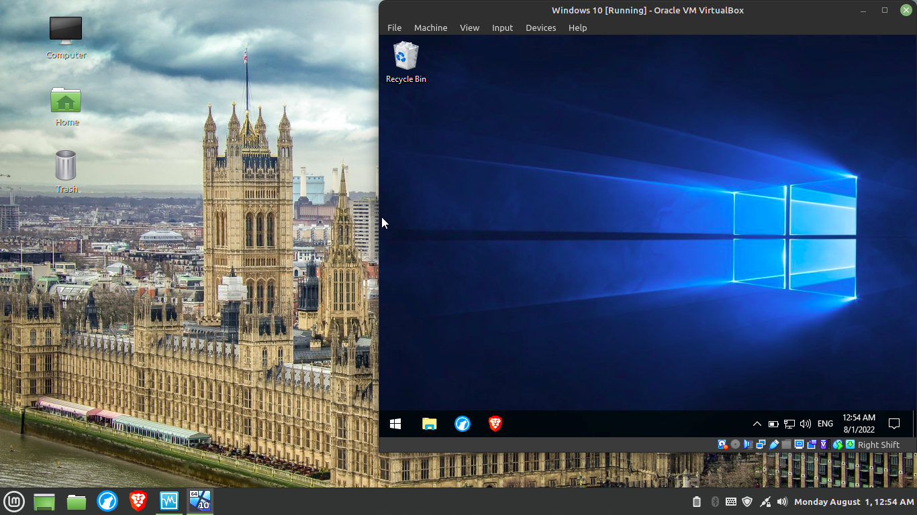
To organize information exchange between your primary operating system (e.g., Windows) and virtual OSs, you typically rely on features provided by the virtualization software you are using. Here's a general approach using common virtualization software like VMware or VirtualBox:
Shared Folders: Most virtualization software allows you to set up shared folders between the host (primary OS) and guest (virtual OS). This enables seamless file transfer between the two environments.
Clipboard Integration: Virtualization software often supports clipboard integration, allowing you to copy text or files from the primary OS and paste them directly into the virtual OS, and vice versa.
Drag and Drop: Some virtualization software also supports drag and drop functionality for transferring files between the primary OS and virtual OS.

Slide 13

For your specific task of copying an audio file from the primary OS to the desktop of the virtual OS and its clone, you can follow these steps:
Shared Folders: Set up a shared folder between your primary OS and the virtual OS. This folder will act as a bridge for transferring files.
Copy Audio File: Navigate to the shared folder from your primary OS and copy the audio file you want to transfer.
Paste to Virtual OS Desktop: Paste the copied audio file into the desktop of the virtual OS by navigating to the shared folder from within the virtual OS environment.
Repeat for Clone: If you have a clone of the virtual OS, you can repeat the process by navigating to the shared folder and copying the audio file to the clone's desktop.

Slide 14

For copying a document from the desktop of the virtual OS to your primary OS, you can follow similar steps:
Shared Folders: Ensure you have a shared folder set up between the primary OS and the virtual OS.
Copy Document: Locate the document you want to copy on the desktop of the virtual OS.
Paste to Shared Folder: Copy the document and paste it into the shared folder from within the virtual OS.
Access from Primary OS: Navigate to the shared folder from your primary OS and copy the document to your desired location.

Slide 15

Conclusions:
During the execution of this Work Case, I have improved my skills in working with cloning, exporting my virtual operating system. Set up a network between my host OS and its clone. And etc. In summary, effective communication and file sharing mechanisms are vital for seamless integration between virtual and host operating systems, contributing to enhanced productivity and flexibility in computing environments.
Author – Kateryna Hranat

Slide 16
Thank you for attention!

